Slide 1

Instructor Kick-off
Analyze A/B Test Results
© 2019 Udacity. All rights reserved.

Slide 2
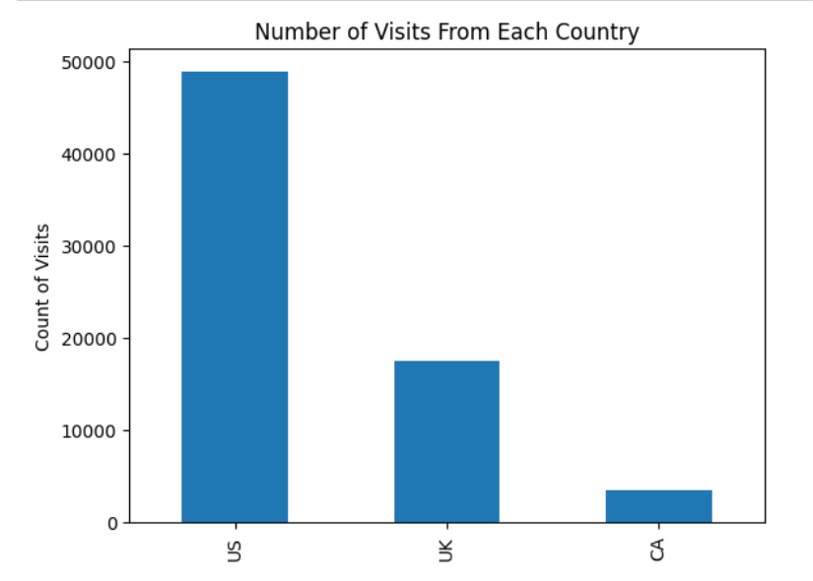
How Was The Experiment Implemented?​
Total Variant Visitors: 6,9889
Total Control Participants:​ 34,678

Slide 3
Conversion Rates
 | U.S. | U.K. | CA
Control | 10.7% | 10.16% | 9.45%
Treatment | 15.8% | 14.87% | 15.40%
Executive Summary: The data suggests a strong association between the treatment group and increased conversion rates, indicating that implementing the new design could lead to improved performance. The variations in conversion rates by country also highlight the need for tailored strategies in different markets. Continued monitoring and further A/B testing could help refine approaches and maximize conversion across all regions. The evidence supports a recommendation to implement the new treatment page, as it demonstrates a positive impact on conversion rates.

Slide 4
Experiment Results
Treatment Conversion Rate: 15.5%
Control Conversion Rate:​ 10.5%
Delta in Treatment vs. Control Conversion Rate:​ 5%
p-value:​ 0
Conclusion:​ With a treatment conversion rate of 15.5% and a control conversion rate of 10.5%, there is a 5% increase in conversions for the treatment group compared to the control. Given a p-value of 0, this difference is statistically significant, meaning it is highly unlikely that the observed difference occurred by chance. The results suggest that the treatment page is more effective than the control page in converting users, with strong statistical evidence supporting this conclusion. Based on this finding, implementing the treatment page would likely lead to a meaningful improvement in conversions.

Slide 5
Country Results
Conclusion:​ There are differences in conversion rates between countries.
Control Group: Coversion rates are relatively similar but still show some variation.
US: 10.7%
UK: 10.16%
CA: 9.45%
Treatment Group: Here the conversion rates are consistently higher than in the control group, with Canada and US showing similare improvements, whie the UK lags slightly.
US: 15.8%
UK: 14.87%
CA: 15.4%
These results suggest that while the treatment has generally incresased conversion rates across all countries some are more responsive to the changes than others. This insight could be useful for tailoring future marketing or product decisions, especially if aiming to maximize conversion in specific markets.

